Slide 1
2022 Robocup Cospace Rescue Asia-Pacific (Finals)
Members:
Hayden How
Lim Chang Jun
Josiah Delroy Huang
Team: Segmentation Fault (RCAP22SG7084)
Anderson Secondary School

Slide 2
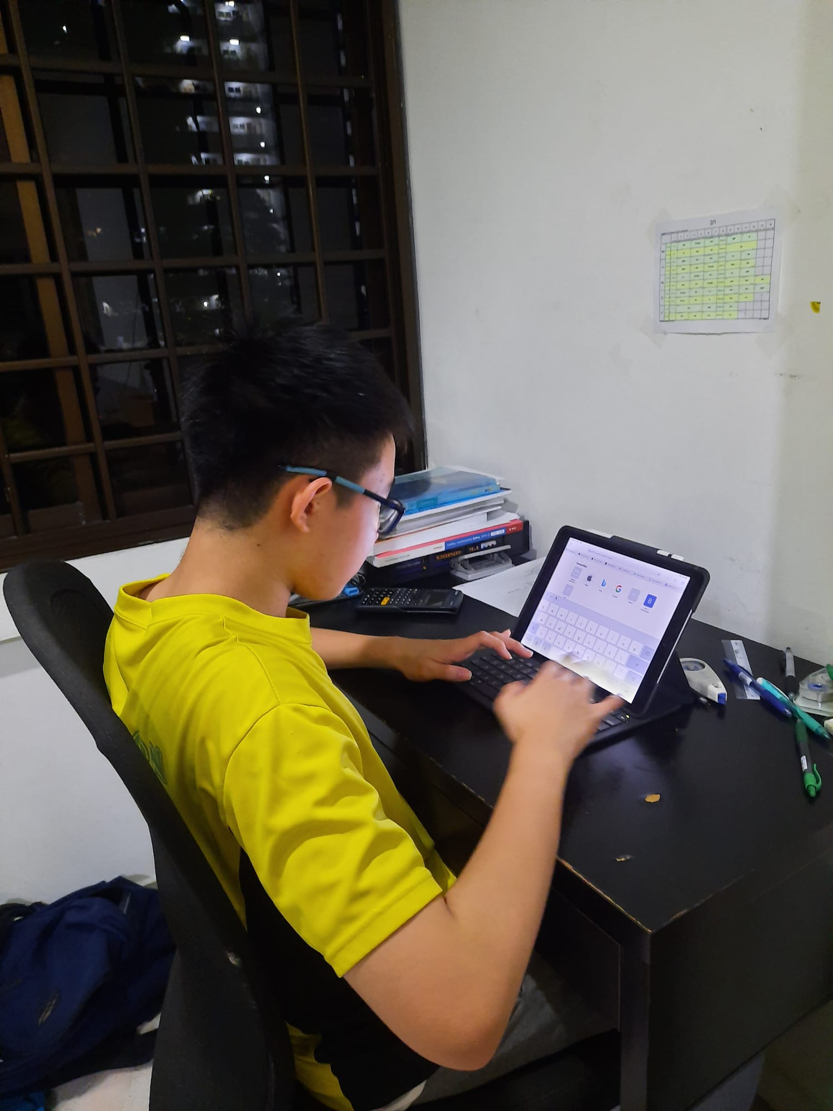
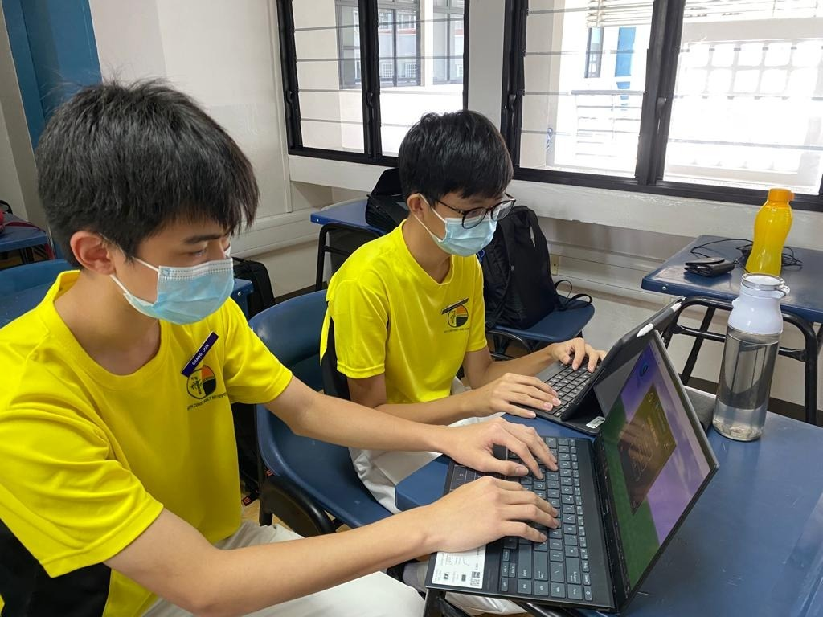
My Team
Josiah Delroy Huang
Lim Chang Jun
Hayden How
Participated in RCAP Cospace Rescue Singapore
Participated in RCAP Tianjin Invitational

Slide 3
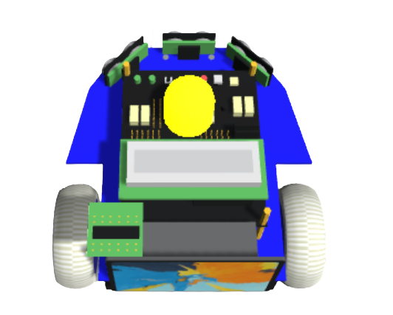
Executive Summary of Preliminary Challenge
Collecting objects to gain points (Red, Cyan, Black, Super, Super Plus)
Depositing current objects on robot (Maximum of 6 loaded objects)
Avoiding obstacles, traps and staying within the border
Double point zones, swamp area and position info lost zones
Have a strategy to maximise the number of points gained
Collecting objects to gain points (Red, Cyan, Black, Super, Super Plus)
Depositing current objects on robot (Maximum of 6 loaded objects)
3.
Avoiding obstacles, traps and staying within the border
4.
Double point zones, swamp area and position info lost zones
5.
Have a strategy to maximise the number of points gained

Slide 4
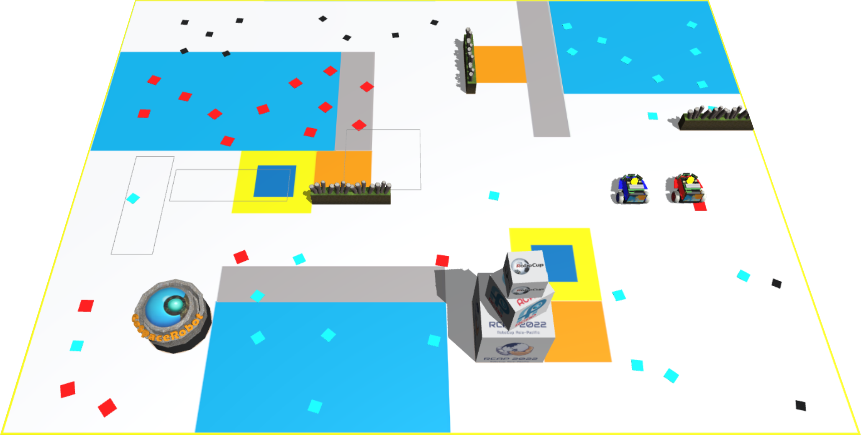



Summary of The Prelim Round Map
3 deposit zones that is close to trap, swamp and obstacle
3 deposit zones that is close to trap, swamp and obstacle
Red objects mainly concentrated at the top left side of the map and Cyan mainly found in top right side
Black object can be found in the area above the double point zone
Red objects mainly concentrated at the top left side of the map and Cyan mainly found in top right side
2.
Black object can be found in the area above the double point zone
3.

Slide 5
Overview
Picking up objects
Navigating around the map
Targeting specific parts of the map
PID Control

Slide 6
1. Optimal Combination Of Objects
Red (10 points), cyan (15 points) and black (20 points) objects are found around the map
Super (90 points) objects are made by a set of objects (1 Red, 1 Cyan, 1 Black) deposited
Super plus objects (180 points) are made by 2 sets of objects (2 Red, 2 Cyan, 2 Black)
Super objects’ coordinates will be given, making pathfinding possible
Red (10 points), cyan (15 points) and black (20 points) objects are found around the map
Super (90 points) objects are made by a set of objects (1 Red, 1 Cyan, 1 Black) deposited
(x,y)
Super plus objects (180 points) are made by 2 sets of objects (2 Red, 2 Cyan, 2 Black)
Super objects’ coordinates will be given, making pathfinding possible

Slide 7
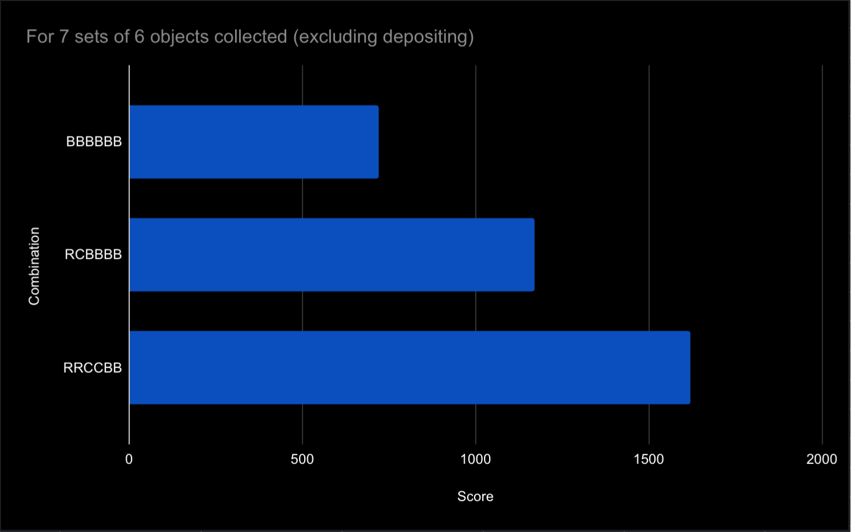
1. Optimal combination of objects
Graph for scores of each combination; including super and super plus objects
BBBBBB (720)
RCBBBB (1170)
RRCCBB (1620)

Slide 8
1. Picking up super and normal objects
Ordering of objects picked up should be optimal to minimise time wasted
First get as many pairs of RRBBCC as possible (To create super+ objects)
Once number of super+ objects reach 6, pick them up
Deposit only when object the robot is fully loaded with objects to minimise time depositing

Slide 9


2. Avoiding obstacles, border, swamp area, traps
Screenshot of map is taken and Microsoft paint used to simplify the map into simple colours
OpenCV used to generate a 2d array of the map converted to some numbers indicating the type (1 for wall, 2 for free spot etc.)

Slide 10
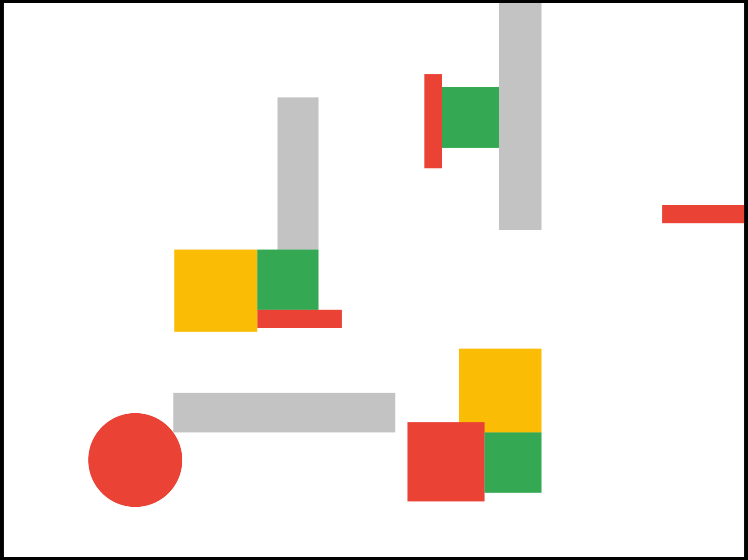
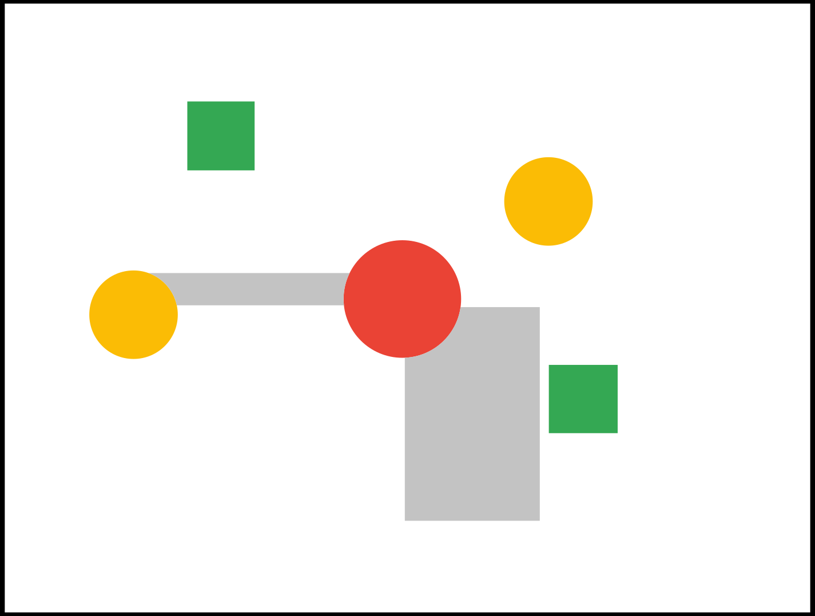
2. Avoiding obstacles, border, swamp areas and traps
{3,3,3,3,3,3,3,3,3,3,3,3,3,3,3,3,3,3,3,3,3,3,3,3,3,3,3,3,3,3,3,3,3,3,3,3,3,3,3,3},
{3,3,3,3,3,3,3,3,3,3,3,3,3,3,3,3,3,3,3,3,3,3,3,3,3,3,3,3,3,3,3,3,3,3,3,3,3,3,3,3},
{3,3,3,3,3,3,3,3,3,3,3,3,3,3,3,3,3,3,3,3,3,3,3,3,3,3,3,3,3,3,3,3,3,3,3,3,3,3,3,3},
{3,3,3,3,3,3,3,3,3,3,3,3,3,3,3,3,3,3,3,3,3,3,3,3,3,3,3,3,3,3,3,3,3,3,3,3,3,3,3,3},
{3,3,3,3,3,3,3,3,3,3,3,3,3,3,3,3,3,3,3,3,3,3,3,3,3,3,3,3,3,3,3,3,3,3,3,3,3,3,3,3},
{3,3,3,3,3,3,3,3,3,4,4,4,4,3,3,3,3,3,3,3,3,3,3,3,3,3,3,3,3,3,3,3,3,3,3,3,3,3,3,3},
{3,3,3,3,3,3,3,3,3,4,4,4,4,3,3,3,3,3,3,3,3,3,3,3,3,3,3,3,3,3,3,3,3,3,3,3,3,3,3,3},
{3,3,3,3,3,3,3,3,3,4,4,4,4,3,3,3,3,3,3,3,3,3,3,3,3,3,3,3,3,3,3,3,3,3,3,3,3,3,3,3},
{3,3,3,3,3,3,3,3,3,1,1,1,1,3,3,3,3,3,3,3,3,3,3,3,3,3,0,0,0,3,3,3,3,3,3,3,3,3,3,3},
{3,3,3,3,3,3,3,3,3,3,3,3,3,3,3,3,3,3,3,3,3,3,3,3,3,0,0,0,0,0,3,3,3,3,3,3,3,3,3,3},
{3,3,3,3,3,3,3,3,3,3,3,3,3,3,3,3,3,3,3,3,3,3,3,3,3,0,0,0,0,0,3,3,3,3,3,3,3,3,3,3},
{3,3,3,3,3,3,3,3,3,3,3,3,3,3,3,3,3,3,3,3,3,3,3,3,3,3,0,0,0,3,3,3,3,3,3,3,3,3,3,3},
{3,3,3,3,3,3,3,3,3,3,3,3,3,3,3,3,3,3,1,2,2,2,3,3,3,3,3,3,3,3,3,3,3,3,3,3,3,3,3,3},
{3,3,3,3,3,3,3,3,3,3,3,3,3,3,3,3,3,3,2,2,2,2,2,3,3,3,3,3,3,3,3,3,3,3,3,3,3,3,3,3},
{3,3,3,3,3,0,0,0,0,1,1,1,1,1,1,1,1,2,2,2,2,2,2,3,3,3,3,3,3,3,3,3,3,3,3,3,3,3,3,3},
{3,3,3,3,1,0,0,0,0,3,3,3,3,3,3,3,3,2,2,2,2,2,2,1,1,1,1,3,3,3,3,3,3,3,3,3,3,3,3,3},
{3,3,3,3,3,0,0,0,0,3,3,3,3,3,3,3,3,3,2,2,2,2,2,1,1,1,1,3,3,3,3,3,3,3,3,3,3,3,3,3},
{3,3,3,3,3,0,0,0,0,3,3,3,3,3,3,3,3,3,3,2,2,2,1,1,1,1,1,3,3,3,3,3,3,3,3,3,3,3,3,3},
{3,3,3,3,3,3,3,3,3,3,3,3,3,3,3,3,3,3,3,3,1,1,1,1,1,1,1,4,4,4,4,3,3,3,3,3,3,3,3,3},
{3,3,3,3,3,3,3,3,3,3,3,3,3,3,3,3,3,3,3,3,1,1,1,1,1,1,1,4,4,4,4,3,3,3,3,3,3,3,3,3},
{3,3,3,3,3,3,3,3,3,3,3,3,3,3,3,3,3,3,3,3,1,1,1,1,1,1,1,4,4,4,4,3,3,3,3,3,3,3,3,3},
{3,3,3,3,3,3,3,3,3,3,3,3,3,3,3,3,3,3,3,3,1,1,1,1,1,1,1,4,4,4,4,3,3,3,3,3,3,3,3,3},
{3,3,3,3,3,3,3,3,3,3,3,3,3,3,3,3,3,3,3,3,1,1,1,1,1,1,1,3,3,3,3,3,3,3,3,3,3,3,3,3},
{3,3,3,3,3,3,3,3,3,3,3,3,3,3,3,3,3,3,3,3,1,1,1,1,1,1,1,3,3,3,3,3,3,3,3,3,3,3,3,3},
{3,3,3,3,3,3,3,3,3,3,3,3,3,3,3,3,3,3,3,3,1,1,1,1,1,1,1,3,3,3,3,3,3,3,3,3,3,3,3,3},
{3,3,3,3,3,3,3,3,3,3,3,3,3,3,3,3,3,3,3,3,1,1,1,1,1,1,1,3,3,3,3,3,3,3,3,3,3,3,3,3},
{3,3,3,3,3,3,3,3,3,3,3,3,3,3,3,3,3,3,3,3,3,3,3,3,3,3,3,3,3,3,3,3,3,3,3,3,3,3,3,3},
{3,3,3,3,3,3,3,3,3,3,3,3,3,3,3,3,3,3,3,3,3,3,3,3,3,3,3,3,3,3,3,3,3,3,3,3,3,3,3,3},
{3,3,3,3,3,3,3,3,3,3,3,3,3,3,3,3,3,3,3,3,3,3,3,3,3,3,3,3,3,3,3,3,3,3,3,3,3,3,3,3},
{3,3,3,3,3,3,3,3,3,3,3,3,3,3,3,3,3,3,3,3,3,3,3,3,3,3,3,3,3,3,3,3,3,3,3,3,3,3,3,3},
{3,3,3,3,3,3,3,3,3,3,3,3,3,3,3,3,3,3,3,3,3,3,3,3,3,3,3,3,3,3,3,1,1,1,3,3,3,3,3,3,3,3,3,3,3,3},
{3,3,3,3,3,3,3,3,3,3,3,3,3,3,3,3,3,3,3,3,3,3,3,3,3,3,3,3,3,3,3,1,1,1,3,3,3,3,3,3,3,3,3,3,3,3},
{3,3,3,3,3,3,3,3,3,3,3,3,3,3,3,3,3,3,3,3,3,3,3,3,3,3,3,3,3,3,3,1,1,1,3,3,3,3,3,3,3,3,3,3,3,3},
{3,3,3,3,3,3,3,3,3,3,3,3,3,3,3,3,3,3,3,3,3,3,3,3,3,3,3,3,3,3,3,1,1,1,3,3,3,3,3,3,3,3,3,3,3,3},
{3,3,3,3,3,3,3,3,3,3,3,3,3,3,3,3,3,3,3,3,3,3,3,3,3,3,3,3,3,3,3,1,1,1,3,3,3,3,3,3,3,3,3,3,3,3},
{3,3,3,3,3,3,3,3,3,3,3,3,3,3,3,3,3,3,3,3,3,3,3,3,3,3,2,2,3,3,3,1,1,1,3,3,3,3,3,3,3,3,3,3,3,3},
{3,3,3,3,3,3,3,3,3,3,3,3,3,3,3,3,3,1,1,1,3,3,3,3,3,3,2,2,4,4,4,1,1,1,3,3,3,3,3,3,3,3,3,3,3,3},
{3,3,3,3,3,3,3,3,3,3,3,3,3,3,3,3,3,1,1,1,3,3,3,3,3,3,2,2,4,4,4,1,1,1,3,3,3,3,3,3,3,3,3,3,3,3},
{3,3,3,3,3,3,3,3,3,3,3,3,3,3,3,3,3,1,1,1,3,3,3,3,3,3,2,2,4,4,4,1,1,1,3,3,3,3,3,3,3,3,3,3,3,3},
{3,3,3,3,3,3,3,3,3,3,3,3,3,3,3,3,3,1,1,1,3,3,3,3,3,3,2,2,3,3,3,1,1,1,3,3,3,3,3,3,3,3,3,3,3,3},
{3,3,3,3,3,3,3,3,3,3,3,3,3,3,3,3,3,1,1,1,3,3,3,3,3,3,2,2,3,3,3,1,1,1,3,3,3,3,3,3,3,3,3,3,3,3},
{3,3,3,3,3,3,3,3,3,3,3,3,3,3,3,3,3,1,1,1,3,3,3,3,3,3,3,3,3,3,3,1,1,1,3,3,3,3,3,3,3,3,3,3,3,3},
{3,3,3,3,3,3,3,3,3,3,3,3,3,3,3,3,3,1,1,1,3,3,3,3,3,3,3,3,3,3,3,1,1,1,3,3,3,3,3,3,3,3,3,3,3,3},
{3,3,3,3,3,3,3,3,3,3,3,3,3,3,3,3,3,1,1,1,3,3,3,3,3,3,3,3,3,3,3,1,1,1,3,3,3,3,3,3,3,2,2,2,2,2},
{3,3,3,3,3,3,3,3,3,3,3,3,3,3,3,3,3,1,1,1,3,3,3,3,3,3,3,3,3,3,3,1,1,1,3,3,3,3,3,3,3,3,3,3,3,3},
{3,3,3,3,3,3,3,3,3,3,3,3,3,3,3,3,3,1,1,1,3,3,3,3,3,3,3,3,3,3,3,3,3,3,3,3,3,3,3,3,3,3,3,3,3,3},
{3,3,3,3,3,3,3,3,3,3,3,0,0,0,0,0,4,4,4,4,3,3,3,3,3,3,3,3,3,3,3,3,3,3,3,3,3,3,3,3,3,3,3,3,3,3},
{3,3,3,3,3,3,3,3,3,3,3,0,0,0,0,0,4,4,4,4,3,3,3,3,3,3,3,3,3,3,3,3,3,3,3,3,3,3,3,3,3,3,3,3,3,3},
{3,3,3,3,3,3,3,3,3,3,3,0,0,0,0,0,4,4,4,4,3,3,3,3,3,3,3,3,3,3,3,3,3,3,3,3,3,3,3,3,3,3,3,3,3,3},
{3,3,3,3,3,3,3,3,3,3,3,0,0,0,0,0,4,4,4,4,3,3,3,3,3,3,3,3,3,3,3,3,3,3,3,3,3,3,3,3,3,3,3,3,3,3},
{3,3,3,3,3,3,3,3,3,3,3,0,0,0,0,0,2,2,2,2,2,3,3,3,3,3,3,3,3,3,3,3,3,3,3,3,3,3,3,3,3,3,3,3,3,3},
{3,3,3,3,3,3,3,3,3,3,3,3,3,3,3,3,3,3,3,3,3,3,3,3,3,3,3,3,3,3,3,3,3,3,3,3,3,3,3,3,3,3,3,3,3,3},
{3,3,3,3,3,3,3,3,3,3,3,3,3,3,3,3,3,3,3,3,3,3,3,3,3,3,3,3,3,0,0,0,0,0,3,3,3,3,3,3,3,3,3,3,3,3},
{3,3,3,3,3,3,3,3,3,3,3,3,3,3,3,3,3,3,3,3,3,3,3,3,3,3,3,3,3,0,0,0,0,0,3,3,3,3,3,3,3,3,3,3,3,3},
{3,3,3,3,3,3,3,3,3,3,3,3,3,3,3,3,3,3,3,3,3,3,3,3,3,3,3,3,3,0,0,0,0,0,3,3,3,3,3,3,3,3,3,3,3,3},
{3,3,3,3,3,3,3,3,3,3,3,1,1,1,1,1,1,1,1,1,1,1,1,1,1,3,3,3,3,0,0,0,0,0,3,3,3,3,3,3,3,3,3,3,3,3},
{3,3,3,3,3,3,3,3,2,3,3,1,1,1,1,1,1,1,1,1,1,1,1,1,1,3,3,3,3,0,0,0,0,0,3,3,3,3,3,3,3,3,3,3,3,3},
{3,3,3,3,3,3,3,2,2,2,2,3,3,3,3,3,3,3,3,3,3,3,3,3,3,3,2,2,2,2,4,4,4,4,3,3,3,3,3,3,3,3,3,3,3,3},
{3,3,3,3,3,3,2,2,2,2,2,3,3,3,3,3,3,3,3,3,3,3,3,3,3,3,2,2,2,2,4,4,4,4,3,3,3,3,3,3,3,3,3,3,3,3},
{3,3,3,3,3,3,2,2,2,2,2,3,3,3,3,3,3,3,3,3,3,3,3,3,3,3,2,2,2,2,4,4,4,4,3,3,3,3,3,3,3,3,3,3,3,3},
{3,3,3,3,3,3,3,2,2,2,3,3,3,3,3,3,3,3,3,3,3,3,3,3,3,3,2,2,2,2,4,4,4,4,3,3,3,3,3,3,3,3,3,3,3,3},
{3,3,3,3,3,3,3,3,3,3,3,3,3,3,3,3,3,3,3,3,3,3,3,3,3,3,3,3,3,3,3,3,3,3,3,3,3,3,3,3,3,3,3,3,3,3},
{3,3,3,3,3,3,3,3,3,3,3,3,3,3,3,3,3,3,3,3,3,3,3,3,3,3,3,3,3,3,3,3,3,3,3,3,3,3,3,3,3,3,3,3,3,3},
{3,3,3,3,3,3,3,3,3,3,3,3,3,3,3,3,3,3,3,3,3,3,3,3,3,3,3,3,3,3,3,3,3,3,3,3,3,3,3,3,3,3,3,3,3,3},
{3,3,3,3,3,3,3,3,3,3,3,3,3,3,3,3,3,3,3,3,3,3,3,3,3,3,3,3,3,3,3,3,3,3,3,3,3,3,3,3,3,3,3,3,3,3},

Slide 11
2. Avoiding obstacles, border, swamp area, traps
2D array can be used for pathfinding which will avoid obstacles
Colour sensor is used for both traps and swamp area avoidance
Coordinates used to avoid borders
Ultrasonic Sensors are used to avoid obstacles and the steering changes depending on how close it is
2D array can be used for pathfinding which will avoid obstacles
Colour sensor is used for both traps and swamp area avoidance
Coordinates used to avoid borders
Ultrasonic Sensors are used to avoid obstacles and the steering changes depending on how close it is

Slide 12
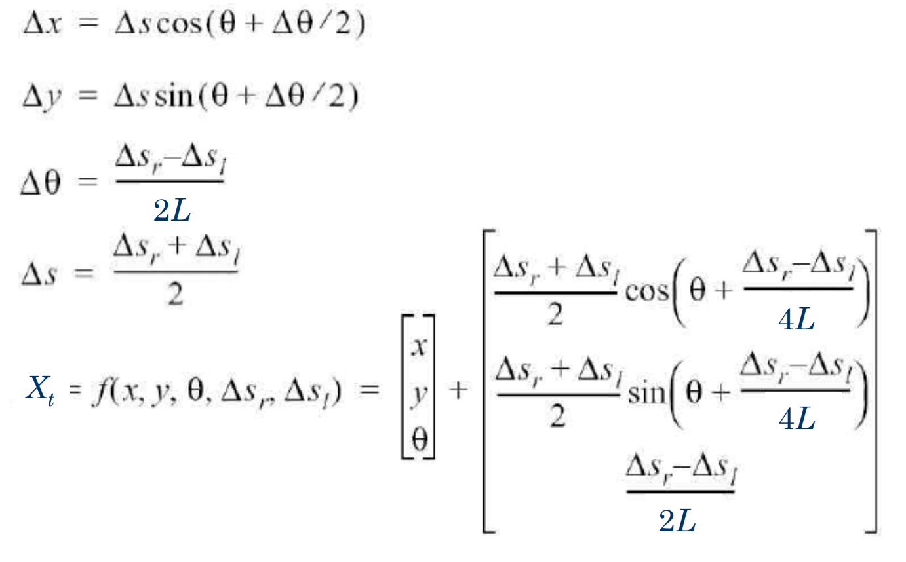
2. Dealing with position info lost zones
Whenever position is not lost, use PositionX and PositionY provided by simulator
Once lost, do odometry to calculate the new Position X and Position Y based on wheel speeds and compass of robot using the formula below

Slide 13
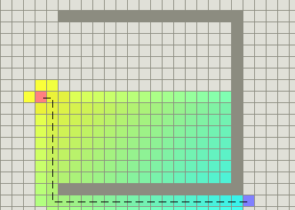
3. Pathfinding for deposit zones and super objects
Since coordinates of super object is given and deposit zones are known, pathfinding can be used to find shortest path from robot to super object and deposit zone
Which algorithm?
Breadth First Search O(V + E)
A star O(V + E log V)
Dijkstra’s algorithm O(V + E log V)
Bellman-Ford / Shortest Path Faster Algorithm O(VE)
Breadth First Search O(V + E)
A star O(V + E log V)
Dijkstra’s algorithm O(V + E log V)
Bellman-Ford / Shortest Path Faster Algorithm O(VE)
Decided to use A star as it uses a heuristic
and will be faster in most of the cases even
with a slower time complexity
Shoots towards target instead of exploring everything around it

Slide 14
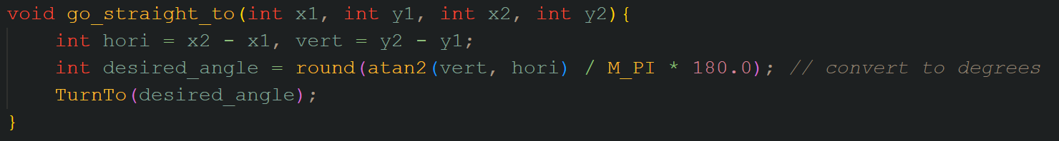
3. Pathfinding for deposit zones and super objects
Atan2() function can be used to find the appropriate angle for robot to face
Turn towards the desired angle and move forward once reached

Slide 15
4. Zoning
There are certain zones that are concentrated with object
Increased efficiency by getting robot to search in these spots rather than other less concentrated zones

Slide 16
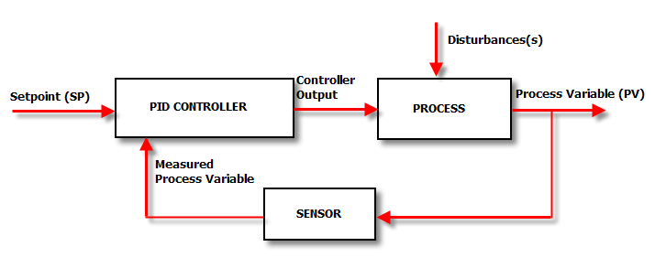
4. PID Control (Proportional, Integral, Derivative)
A control loop mechanism to fix errors
Can be used for smooth path following where error is distance between target angle and desired angle

Slide 17
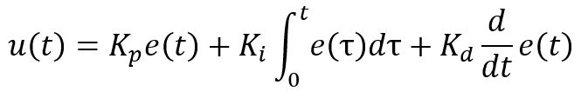
4. PID Control (Proportional, Integral, Derivative)
E(t) is the error value
This is defined to be any value that measures how far off we are away from our desired condition
In our case, the desired condition is a target angle and the error is how far our current angle is away from the target angle
U(t) is the control variable which measures how fast do we want to move
In our case, it is the steering rate of the robot towards a target angle

Slide 18
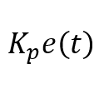
4. P (Proportional)
Kp is the proportional gain which is a constant that is multiplied to the error to scale it properly
This gives us a linear relationship between the error and steering rate, u(t)
This makes path following smoother as the robot knows to turn faster if the current angle is very far away from the target angle and to turn slower once closer to avoid overshooting

Slide 19
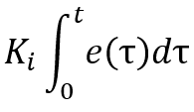
4. I (Integral)
Ki is the integral gain which is another constant multiplied to the integral to scale it properly
The integral is from 0 to t of the error with respect to t (t is time)
Accumulated sum of errors from start to now
Steady-state error occurs when the robot has a very small error such that the proportional gain is not high and the robot ends up being stable while still have an error
Summing up the errors across a period of time makes the robot realise that there still exists an error and to correct it

Slide 20
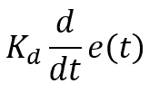
4. D (Derivative)
Kd is the derivative gain which is a constant multiplied to the derivative to scale it properly
The derivative is the derivative of the error with respect to time
Rate of change in error
Overshooting will occurs frequently with proportional control
This will reduce the steering rate if the rate of change in error is too fast, meaning that we are going too fast and need to slow down to avoid overshooting and vice versa

Slide 21
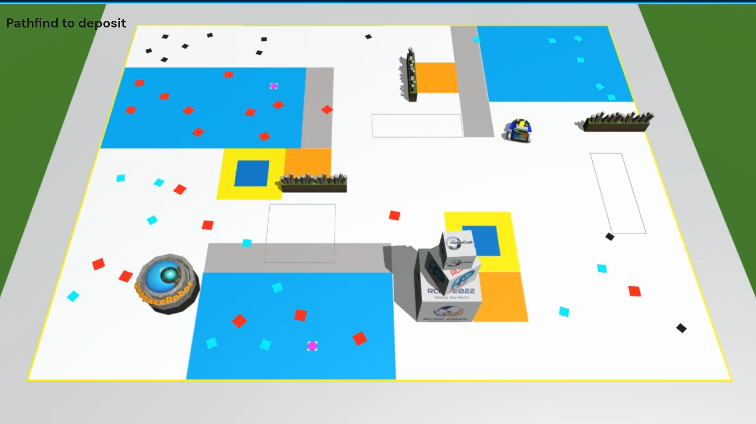
The Game

Slide 22




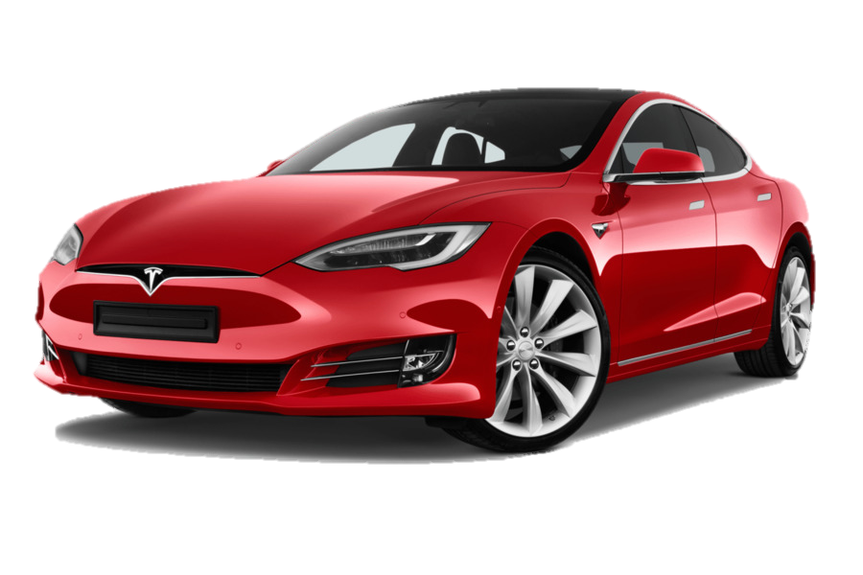
Applying Knowledge Gained to The Real World
Concepts such as pathfinding can be applied to find the shortest path such as google maps’ shortest path algorithm but implemented to robots
Extrapolating the robot’s future position (Position info lost zones) will be useful as sometimes there will be no internet signal
Efficiency (Combination of objects) will be useful to reduce time taken
Avoiding obstacles can be used in car autopilot technology like in a tesla; Can detect nearby obstacles and avoid them efficiently
Concepts such as pathfinding can be applied to find the shortest path such as google maps’ shortest path algorithm but implemented to robots
Extrapolating the robot’s future position (Position info lost zones) will be useful as sometimes there will be no internet signal
Efficiency (Combination of objects) will be useful to reduce time taken
Avoiding obstacles can be used in car autopilot technology like in a tesla; Can detect nearby obstacles and avoid them efficiently

Slide 23


Conclusion
All of these strategies drastically improved the robot’s performance
Average of 300 with a robot that only does obstacle avoidance
Consistnt 2k+ score with our strategies
Main weaknesses
Inefficient zoning around map for objects
Bad obstacle and swamp avoidance
Generally happy with the score we got but think
we could have done better

Slide 24

Conclusion
What can be improved?
Efficiency of zoning around map for object
Obstacle and swamp avoidance
Efficiency of zoning around map for objects
Obstacle and swamp avoidance

Slide 25
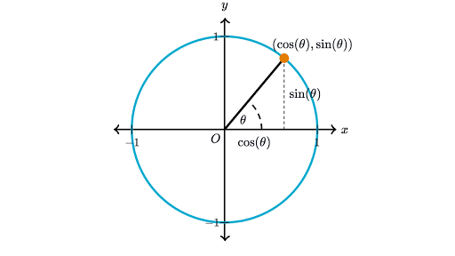
Learning experience
A* search
Trigonometry application
OpenCV
Debugging
PID Control

Slide 26

Acknowledgements
We would like to show our gratitude to our seniors who have guided us throughout the competition
Our teachers for letting us participate in the competition
The organisers for organising and managing the competition

Slide 27

“No matter how much falls on us, we keep plowing ahead. That’s the only way to keep the roads clear”
~ Greg Kincaid

Slide 28

Thank you for your attention!
~ Team Segmentation Fault

